Slide 1
Objectives (Hel 13-16)& Scenarios (3 Ne 1-5)
Book of Mormon

Slide 2
Objectives Hel 13-16
Understand the bigger picture and work of Samuel the Lamanite and contribution to the doctrine and prophesy of the Book of Mormon
Be able to liken the teachings of Samuel the Lamanite to our own lives and then apply what we learned into your daily lives.

Slide 3
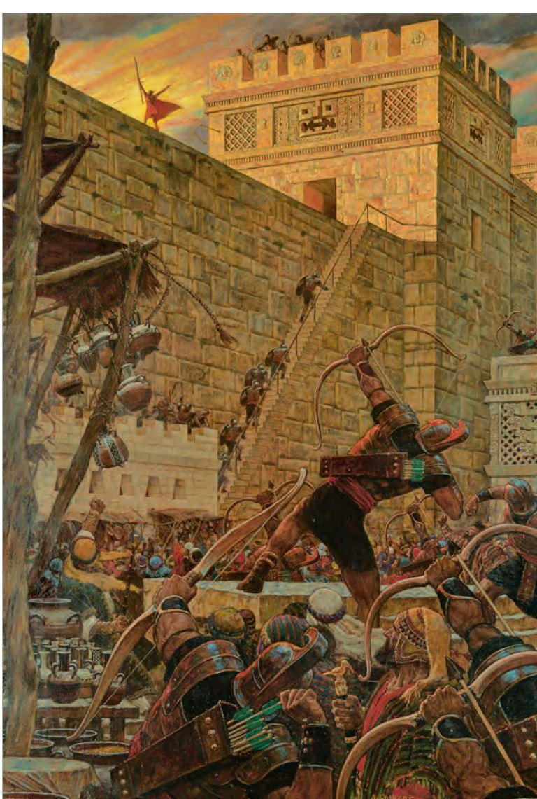
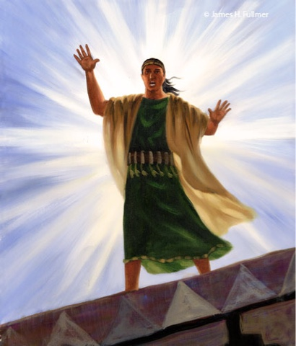

Slide 4
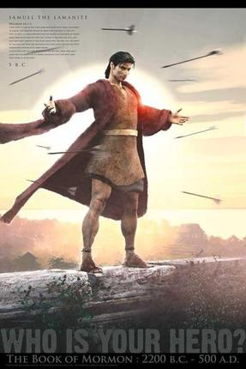
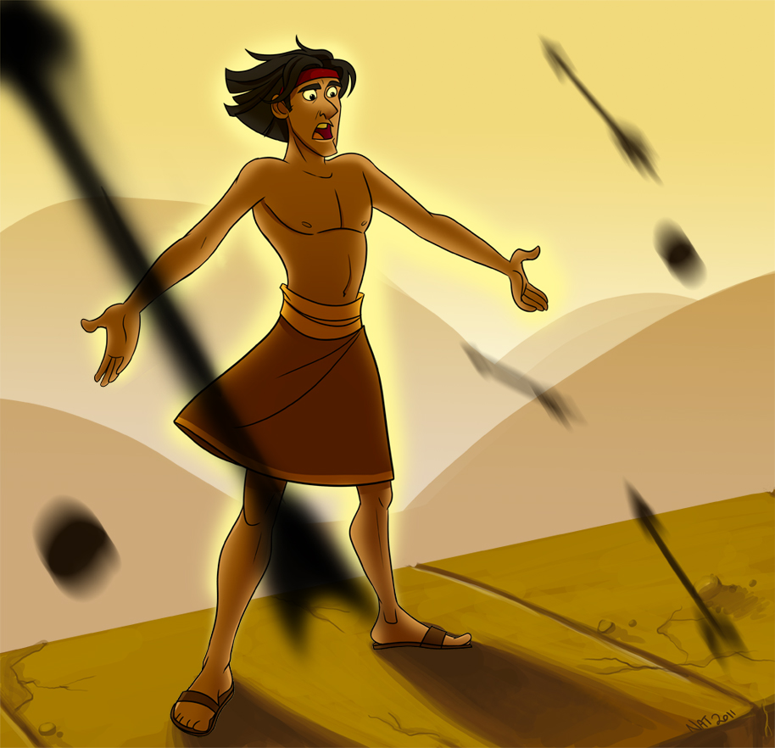
4 Chapters (Hel 13-16)
112 Verses
The story of Samuel the Lamanite…
Only 7 Verses (Hel 13:2-5; Hel 16:2, 6-7)
6.25%
93.75% more of Samuel the Lamanite

Slide 5

Life Scenario
What is going on in your life that you personally need some help with? Write down your own question and then look for principles and doctrines that help you to get answers and guidance to your own question. Be sure to include a quote that you found that helps to give meaning, guidance, and direction to you about your question or situation.

Slide 6
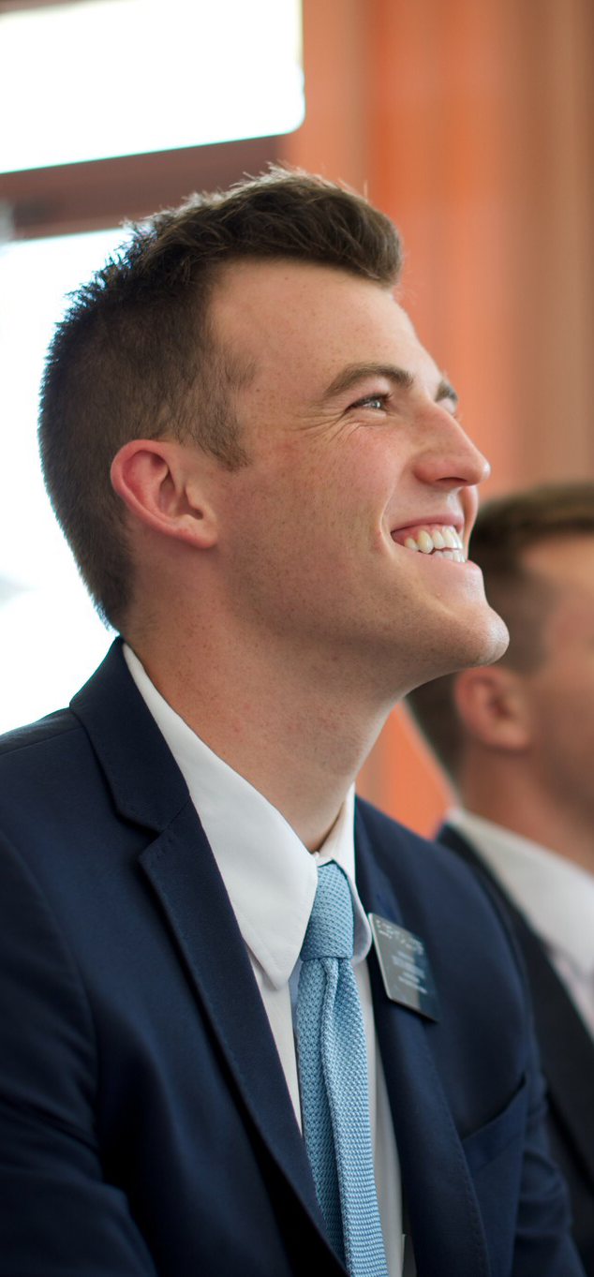
Doctrine/Content
Josh recently just messed up with his girlfriend. He knows he should talk with his bishop but he is nervous and scared not only personally for what this might mean for how the Bishop might view him, but also what it might mean for his schooling here at BYU.
He is a returned missionary and he finds himself confused, frustrated, angry and lacking hope. He keeps asking himself, “What happened? How did I get here?” He is not sure where to go now. He feels lost and confused and lacking any real motivation to change.
At times, like Josh we might all ask ourselves, “Wait a second, how did I get here? What am I doing? How did this start? How did I fall for this?” Using 3 Ne Ch 1-2 and 3:1-11 look for principles and ideas that help Josh understand perhaps the little things, the matter of a few degrees, that may have contributed to where he is at. How can knowing and understanding the consequences of these seemingly small decisions help Josh see where he is at and what he needs to do now?
What if Josh could go back to several months ago and had a chance to do things differently. Using 3 Ne 3:12-26 and Ch 4. What principles would have helped Josh to not only remain faithful, but would have led Josh to become better and closer to the Lord?
Finally, using 3 Ne Ch 5 What principles and ideas would you share with Josh to help him feel hope about his situation and what he can do to humble himself, sincerely repent, and put His trust in the Lord again? What else would you share with Josh to help Him have the courage he needs to go and talk with His bishop and to begin the journey back to the Savior, following in His ways?

